Slide 1

Plantation Society and Social Stratification

Slide 2
Plantation Society Model
Plantation society is class of society with distinguishing characteristics of social structure, political organization, and laws governing social change.
Demographic, political, and socio-economic structures are identical to those found within the individual plantation community.
In the British Caribbean the plantation came to play a dominant role in the economic, social, political and cultural life of the region hence it is referred to as the plantation society because of its vast influence.
Scholars have debated whether the plantation society has assisted in the transition to capitalism in Europe.
The plantation economy not only coerced labour, but also required that the plantation themselves be intensely profit-oriented, commercial enterprises that responded readily to changing the international market signals. Hence, the plantation society and economy is rife (rampant) with inequalities and dominated by a market-oriented ruling class
It was a production machine which separated people by race, colour, status, occupation and ethnicity and the glaring system of social stratification.

Slide 3
Social Stratification: Plantation, Society, & Culture
Whites
Coloured & Freed Blacks
Enslaved Blacks
Plantation is a capitalist type of enterprise - land and by extension people (slaves) are treated as commodities.
Control of the plantation was centralized either by the owner or his attorney; the importation of technology and equipment and the production of mono-crops for an overseas market are all features of the Caribbean plantation system.
Though differences exist among the Caribbean – there are sugar, coffee, cocoa, coconut and sisal (used for making rope, rugs) plantations scattered in the Caribbean – there are distinct features common to all.
Stratification existed amongst slaves; it was based on where they worked whether it be Great House or in the fields.

Slide 4
Characteristics of a Plantation Society
The prevalence of mono-crop agriculture
Heavy dependence on imported products (debts)
Marginalization of the peasantry due to hostility from the plantocracy
Dependence on foreign capital and enterprise as the main investors
Dependence on foreign markets for our crops
Producers of primary products/raw materials
Forced labour systems from early settlement to the twentieth century
A taste/likeness for foreign products
Social stratification based on the gradations of colour and race
Lack of democratic tradition because of the long existence of slavery
Pure Plantation Economy of Slavery
Plantation Economy modified after Emancipation
Plantation Economy further modified after 1940 with ‘Industrialization by Invitation’
They ignored the social forces that contributed to change in the region
Unstable family units, hierarchical class relations, low levels of community integration, mobile populations often recruited for seasonal work

Slide 5
Treatment of Class, Race, & Colour
Light complexion, European physical features and beauty
Notions of ‘good’ and “bad” hair

Slide 6
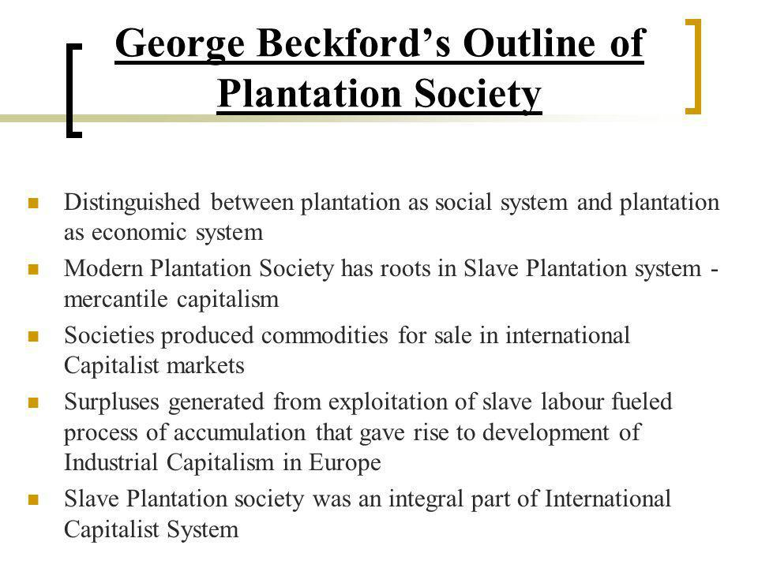
George Beckford

Slide 7
Beckford’s Theory
Beckford says:
Future of Plantation Societies dependent on the future of International Capitalism
Continuing imperialist expansion of Capitalism in new and various forms
The strengthening of popular forces worldwide for national liberation
Hierarchical chain of command formed with White Europeans as owners of the MOP
Occupational structure instituted race in the process of production and set up a class society
Economic spin-off of the Plantation Society is the production of commodities for export to capitalist countries
Trade marked by unequal exchange keeps Plantation Society backward relative to
Industrial Capitalist societies
Post Emancipation - nonagricultural activities, for example, tourism, mining, and light manufacturing etc
The circumstances under which these societies in the Caribbean were formed led to a struggle for freedom and have woven a common thread of conflict throughout our history.
Riots such as the Guerre Negre in Dominica, the Angel of Gabriel in Guyana, the Vox Popular in St Vincent, and the Morant Bay in Jamaica and the Confederation Rebellion in Barbados all have significance in the transformation of the Caribbean society.

Slide 8
Plantation System & Cultural Diversity
Countries with large varying ethnic groups has complex social stratification E.g. Guyana, Trinidad and Jamaica
These new immigrants brought their cultural traits & values with them – East Indian Cuisines, Hindu and Muslim festivals such as Divali, Phagwa and Eid-ul-Fire and the holy days being recognized in a similar manner as Christianity and its festivals and religious ceremonies.
Mixing of races (racial admixture) whereby Blacks were mixing with Whites to produce mulattoes, Blacks and Indians to produce Douglas – hence the creation of a bewildering number of skin colours and features that a unique to the Caribbean.
Scholars argue that a combination between of European and African cultural practices has led to our now Creole culture expressions in Carnival, limbo dancing, calypso, steel pan, the Shango religion in Trinidad and Tobago and Pocomania in Jamaica.
The dialect spoken in each island is dependent on its past inhabitants: St Lucia, Dominica and Grenada have standard and non-standard forms of English and a French based Creole, the Netherlands Antilles has Dutch and Papiamento and Trinidad and Tobago has standard and non-standard forms of English, Bhojpuri and Urdu and a French based Creole and Yoruba are still used by small segments of the society.
These colonies saw the emergence and pronouncement of colour, race and class divisions resulting in hostility with East Indians over space & wages.
Overtime cultural hybridization occurred and a unique form of Creolization that is mixing of cultural traits and exchange of values.

Slide 9
Plantation Aftermath
The culture of oppression and conflict has persisted.
Severe material deprivation and poverty remained with the majority of the working population well into the 1930’s.
Many social upheavals that occurred within a four-year time span across varying islands that were separated by miles of water indicating that discontent was widespread among the masses.
Inquiries by local commissions such as the Deane Commission in Barbados and the Forester Commission in Trinidad exposed the crises and poverty in the West Indian society.
The British Government in response dispatched the Royal Commission to investigate social conditions.
However, the social rebellions were the watershed (breaking point) in the political history of the region upon which contemporary Caribbean society is built.
The Caribbean culture is a rich combination of:
European
African
East Indian
Asian
Colonial and indigenous influences, heritage and cultures
Conclusion: The Caribbean is indeed a multi-national, multi-cultural, and multi-ethnic region.

